Slide 1

Body
Representative
By
Weitao Xiong
Advisor:
Prof. Hongfei Xue

Slide 2
Linear Blend Skinning

Slide 3

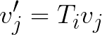
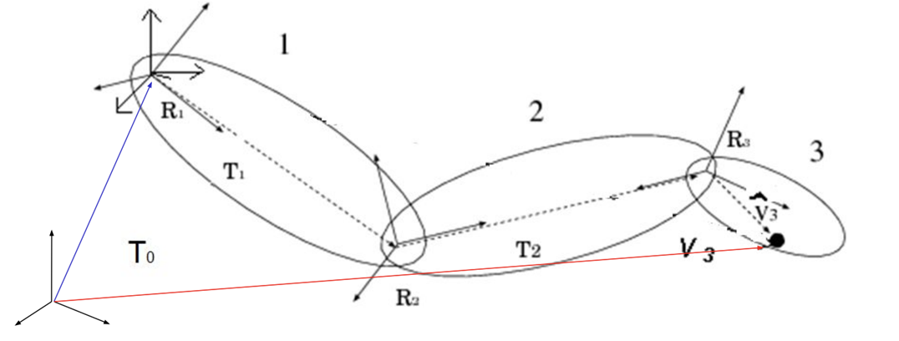
Rigid Skinning
Each skin vertex is assigned to exactly one bone
Consider a vertex 𝑗 with position 𝑣𝑗 in the object space (animated mesh) of the 𝑖th bone with transformation 𝑇𝑖. Then, the world space position of vertex 𝑗 is given by

Slide 4
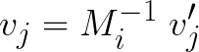
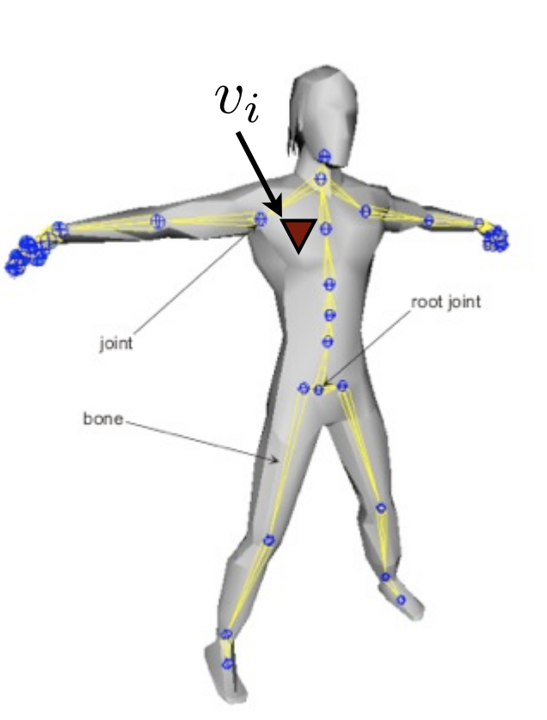
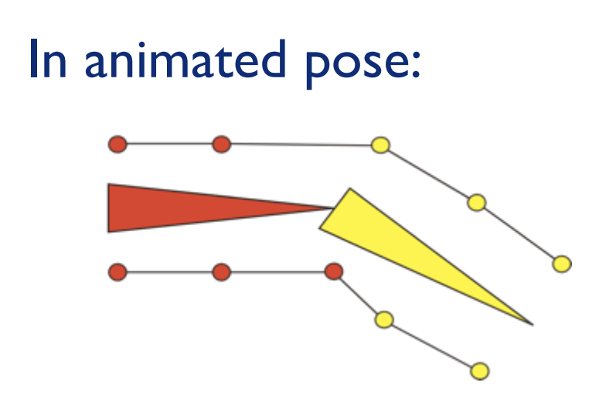
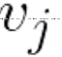
If we know the global position, then we can get joint j in animated mesh
Rigid Skinning Limitations
It will lead to unrealistic non-smooth deformations near joints

Slide 5
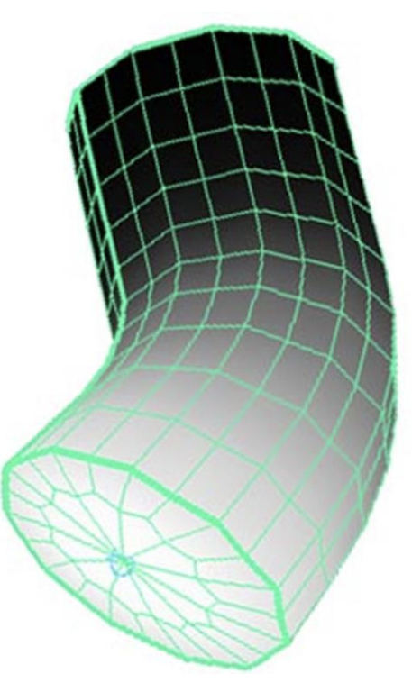
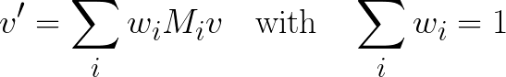
Linear Blend Skinning
Assign each skin vertex to more than one bone.
Remove the discontinuity by linearly blending vertices near the joint.
Where:
is the number of matrices.
is the vertex position.
is the weight associated.
is the transformation matrix.

Slide 6
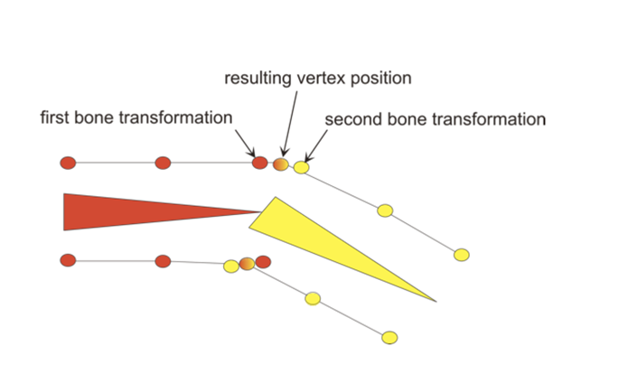
A vertex can be attached to more than one joint/bone with adjustable weights that control how much each joint affects it
Rarely more than 4

Slide 7
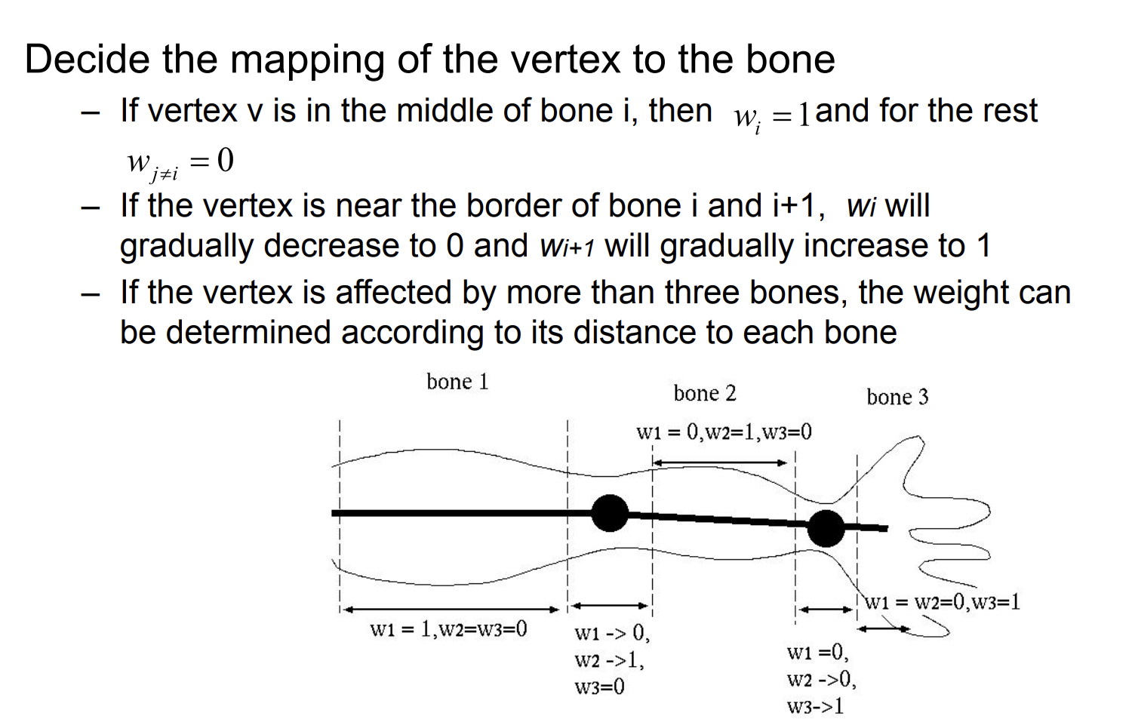
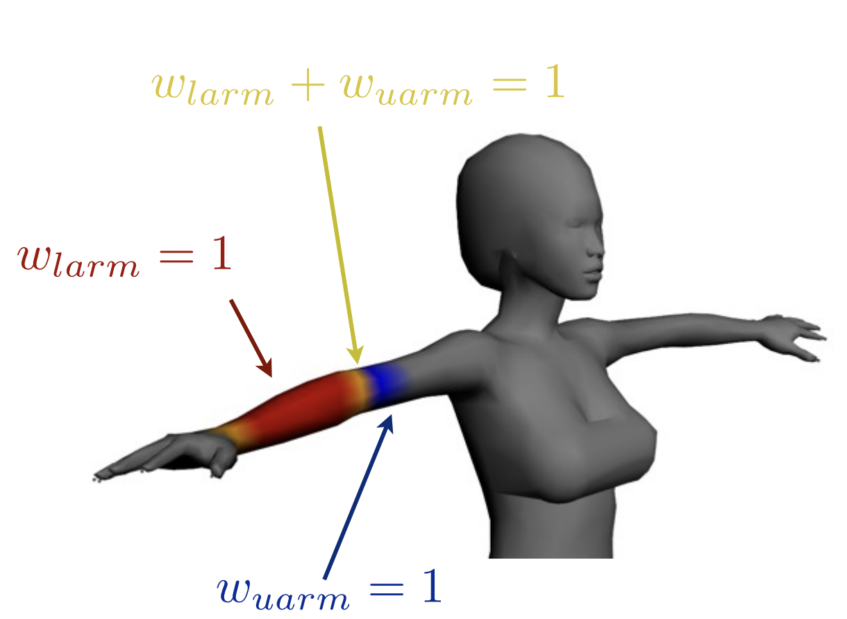
Weight

Slide 8
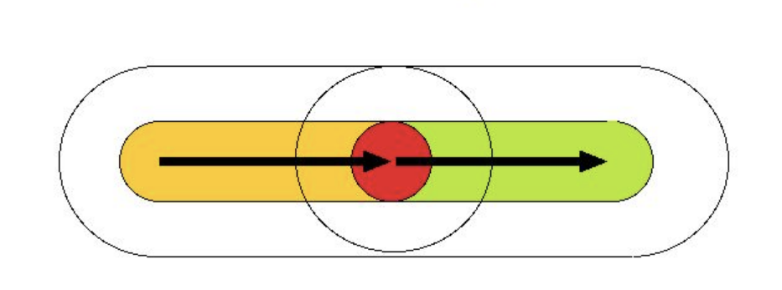
How to decide Weight？
Use the Euclidean distance
•Surround the bones with the inner and outer capsules
•If the vertex is inside only one inner capsule, the weight of the
corresponding bone is 1, and the rest are 0
Outer
Inner

Slide 9
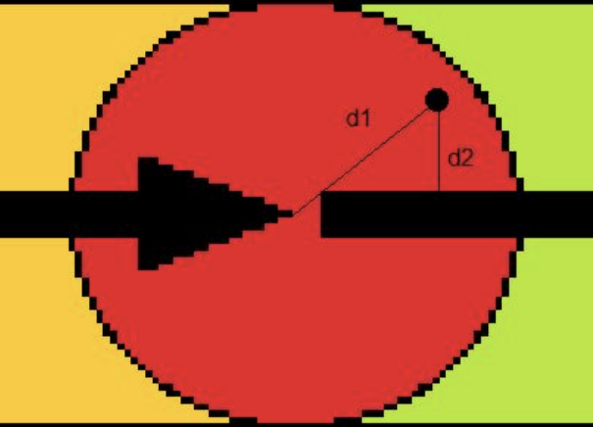
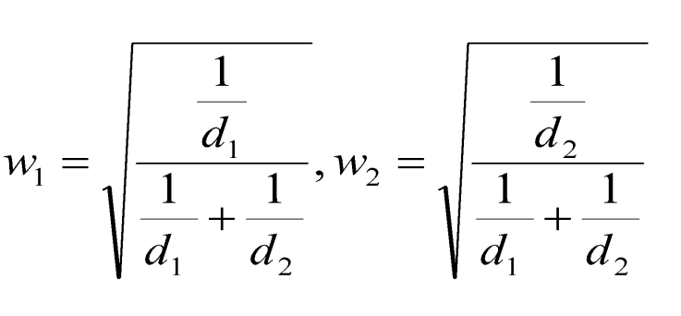
If inside multiple inner capsules, compute the distance to each
bone, and set the weights inversely proportional to the distance
with normalization

Slide 10
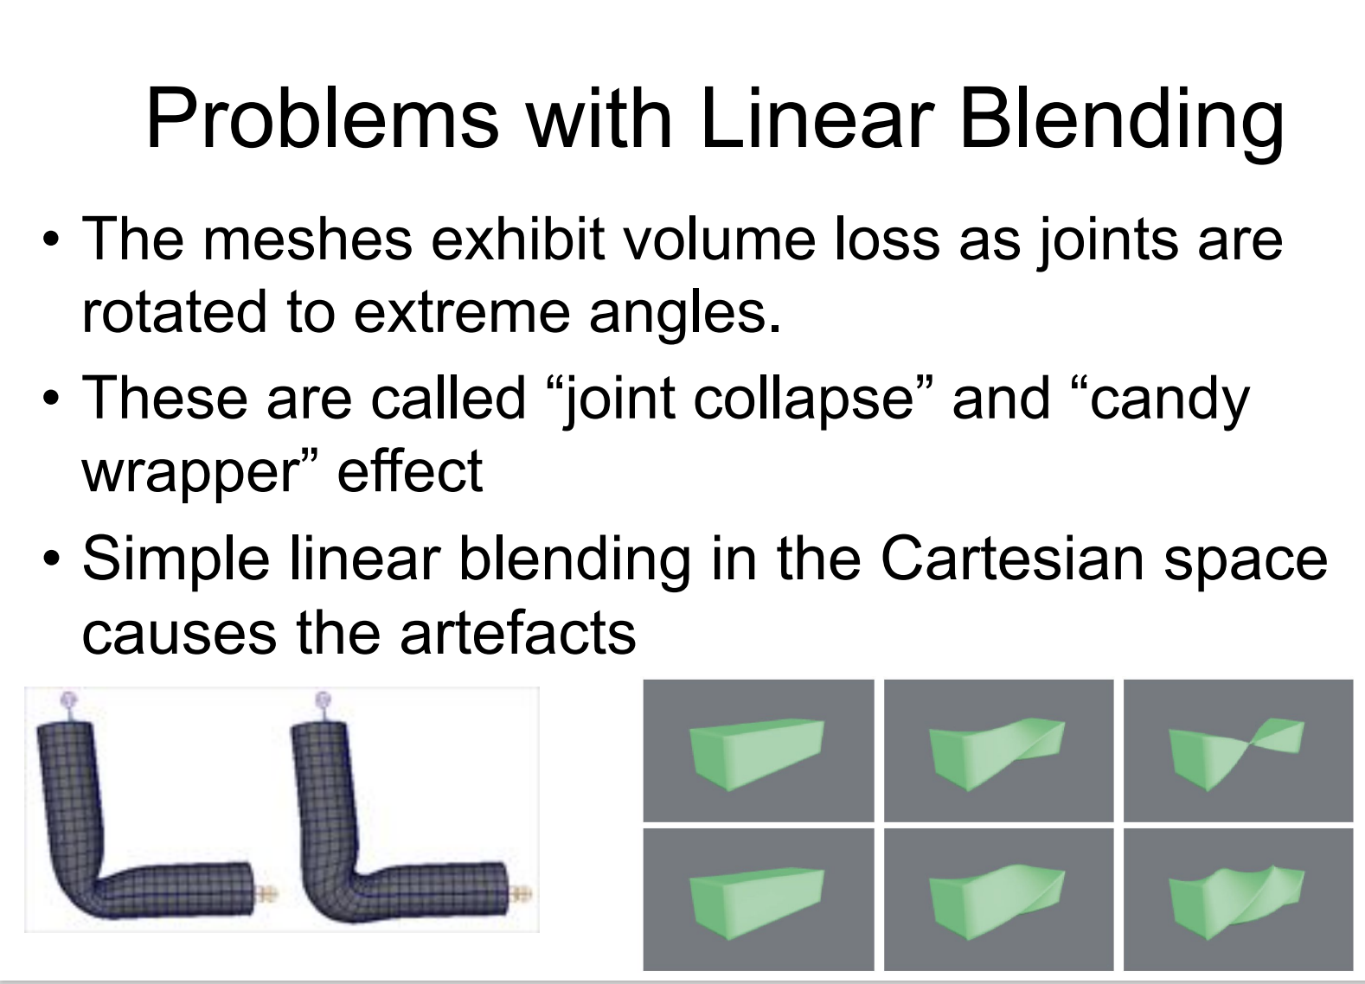
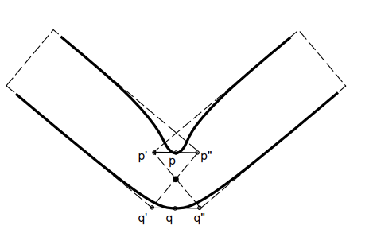

Slide 11
SMPL

Slide 12
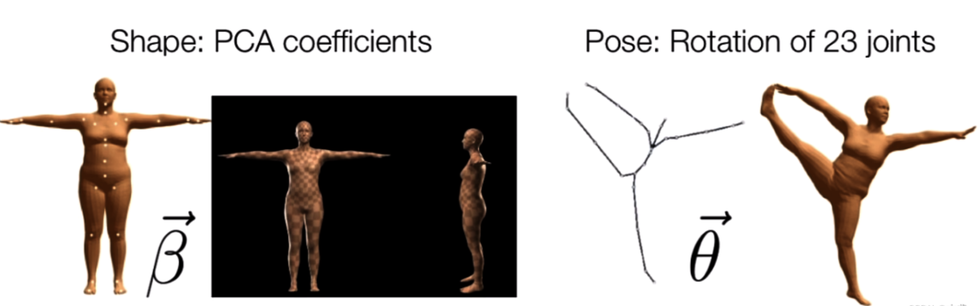
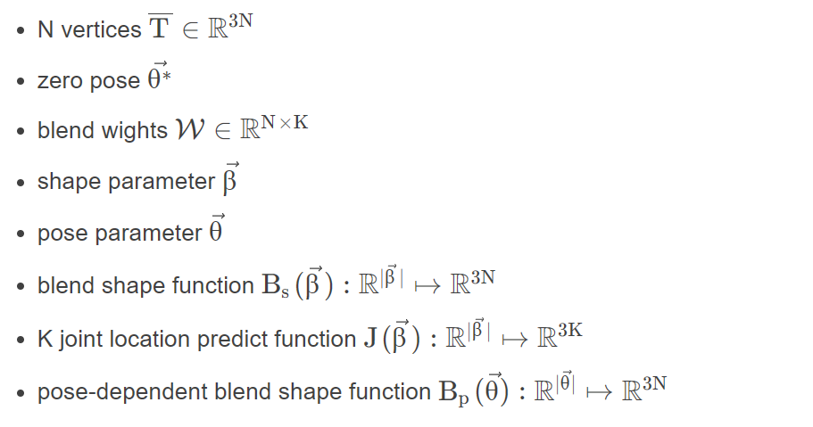
SMPL
SMPL is divided into two sets of parameters:
body shape parameters β
body pose parameters θ.
K = 23, N = 6980

Slide 13
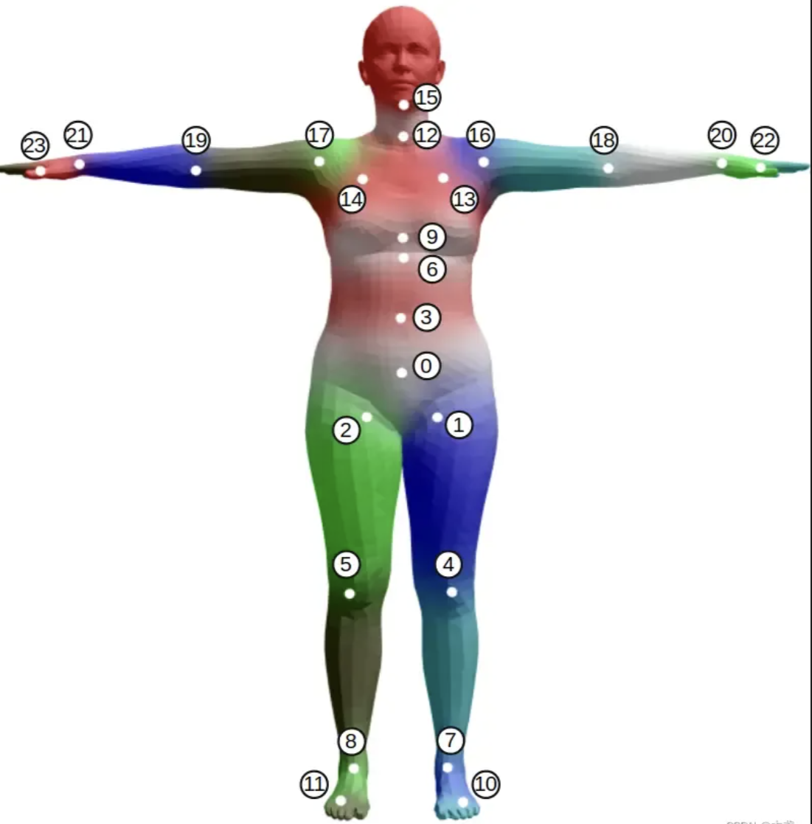
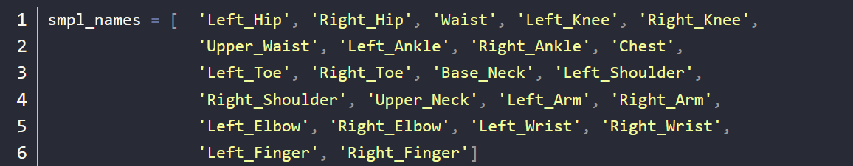
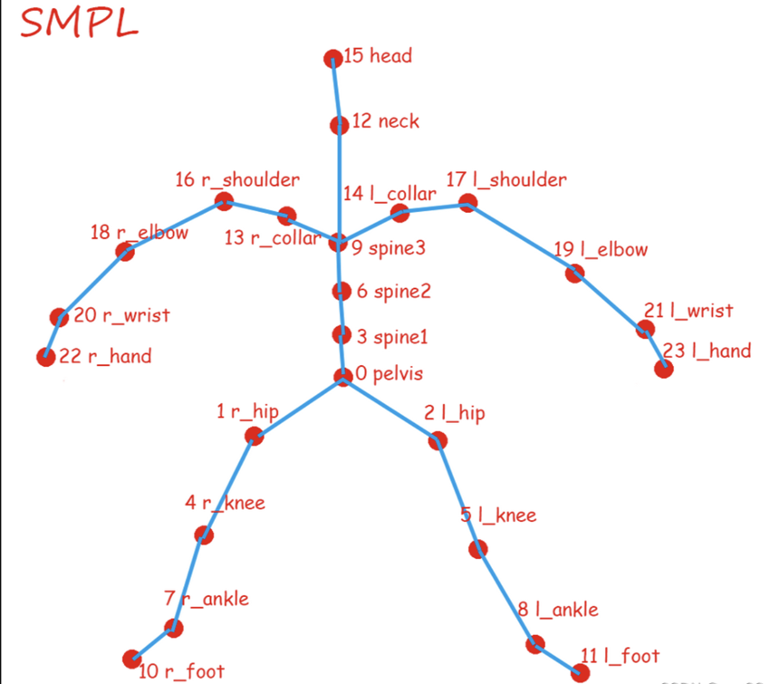
Each human body model has 10 shape parameters and 24x3=72 pose parameters. Therefore, we can represent an SMPL human body using 10+72=82 numbers.

Slide 14
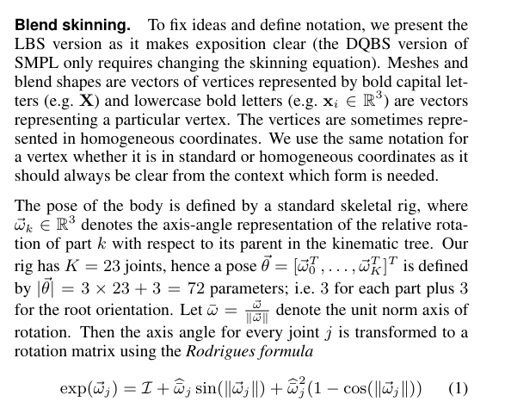
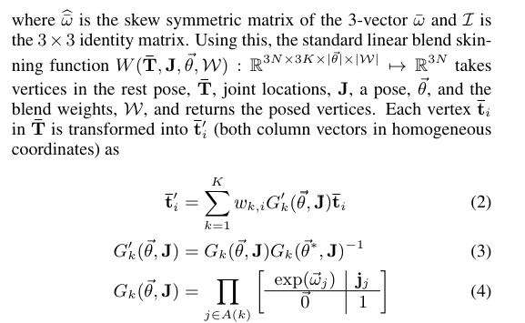

Slide 15
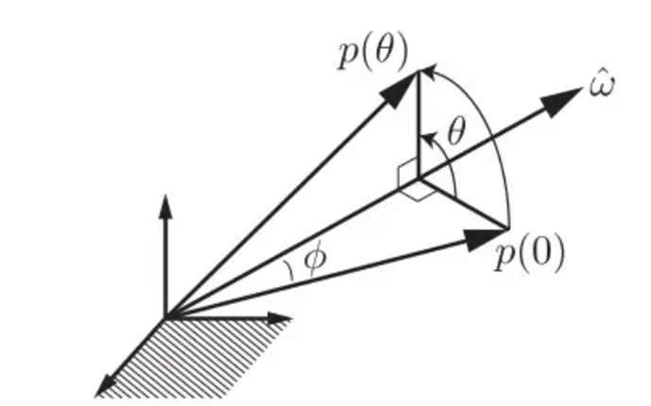
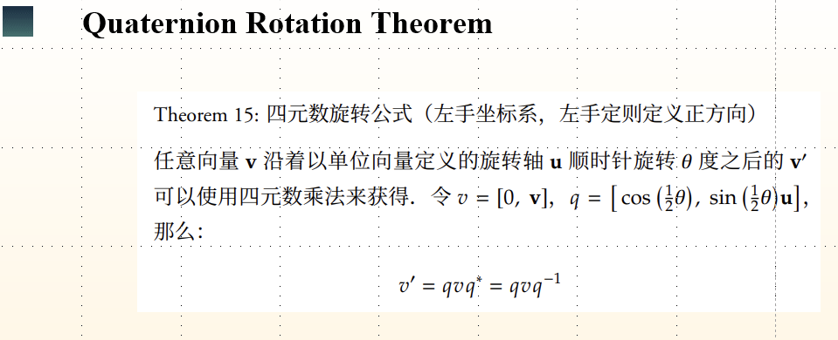
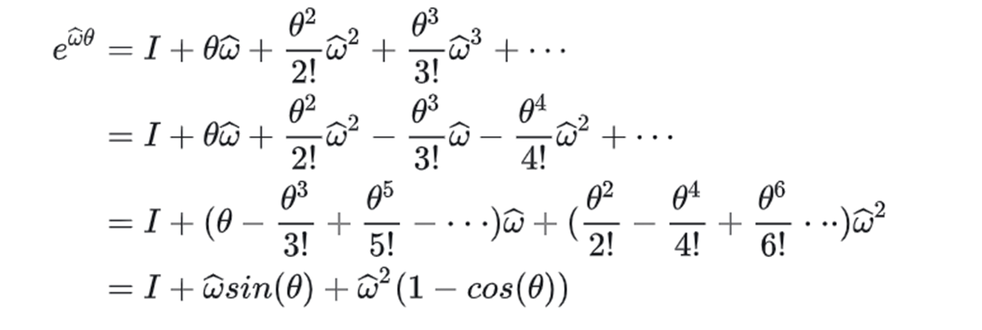
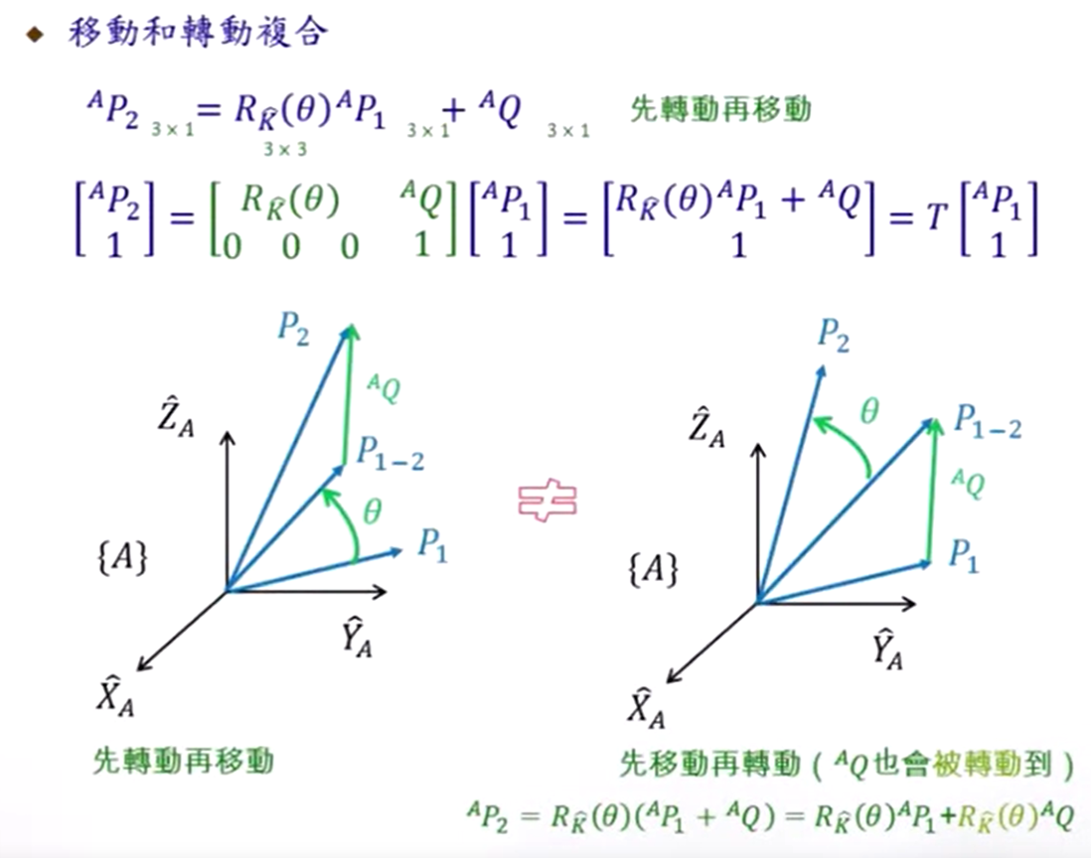
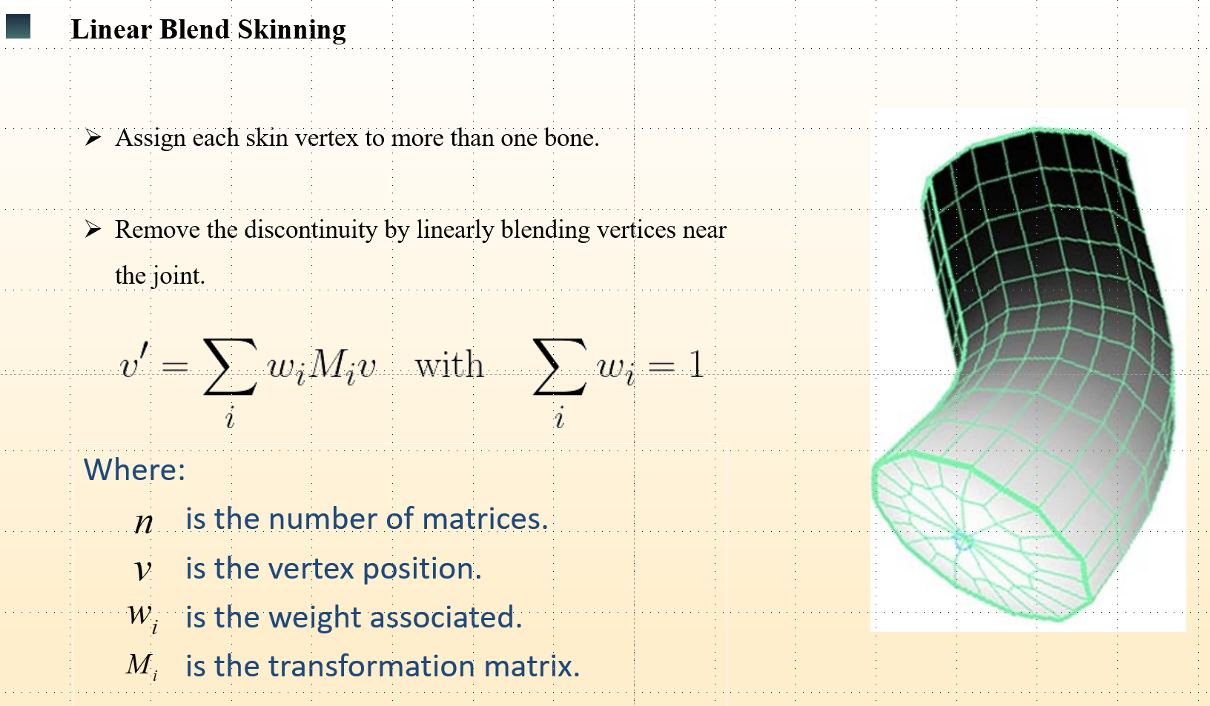
Rodrigues' rotation formula

Slide 16
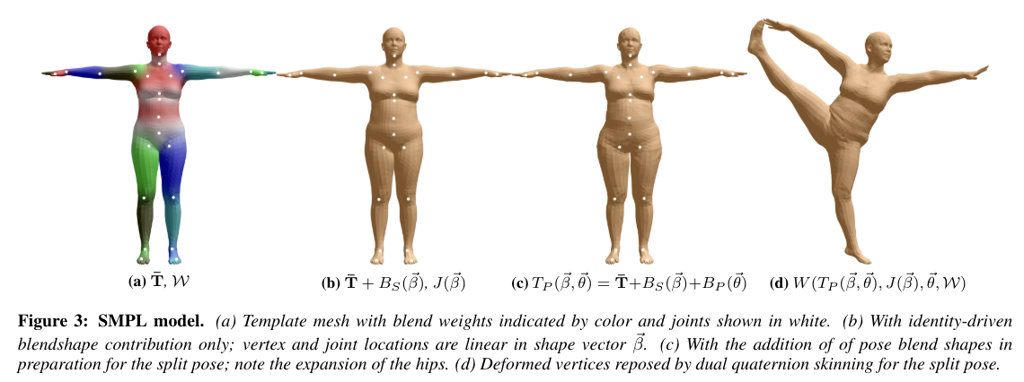
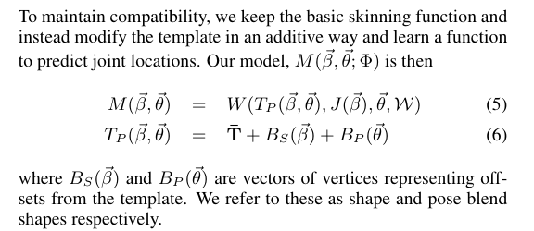
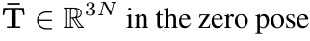
represents vertex offsets due to varying body shapes.
represents vertex offsets due to varying poses.
represents the mean template shape of the human body mesh at a zero pose. It was obtained from the mean of lots of real humans.
standard linear blend skinning function

Slide 17
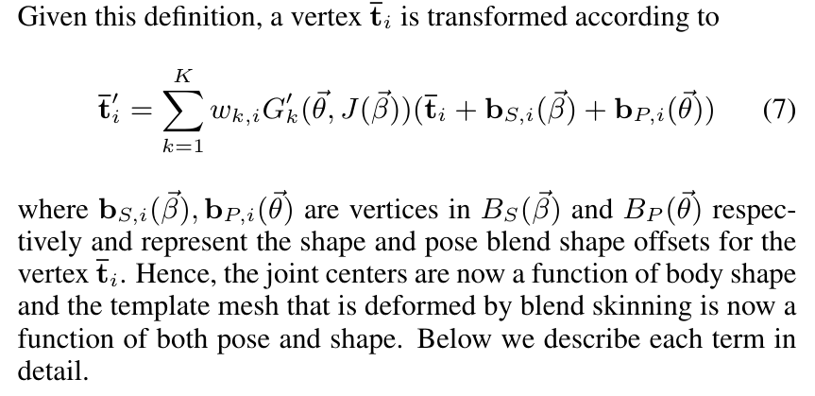
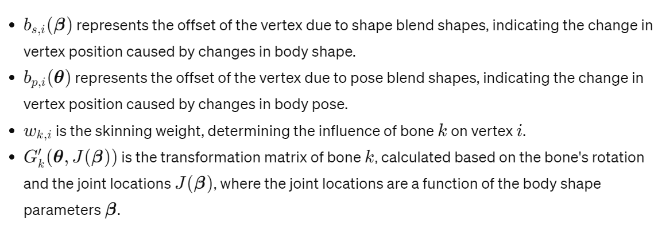

Slide 18
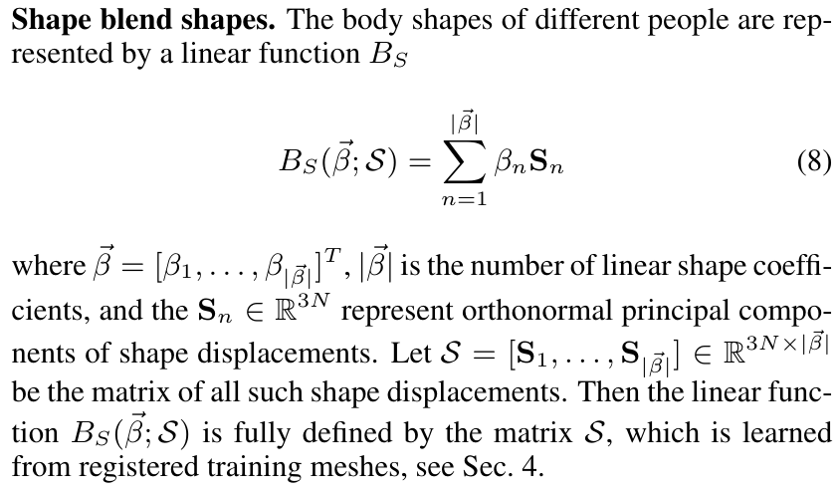
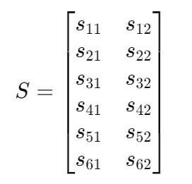
Shape blend shapes
Matrix 𝑆: If your model has 10,000 vertices and PCA reveals 100 principal shape components, then the matrix 𝑆 would be a large 30,000 (3 coordinates for each vertex) by 100-column matrix. Below are 3 vertices and 2 principal shapes.
S was trained by a multi-shape data set which consists of 1786 registrations of 40 individuals (891 registrations spanning 20 females, and 895 registrations spanning 20 males).

Slide 19
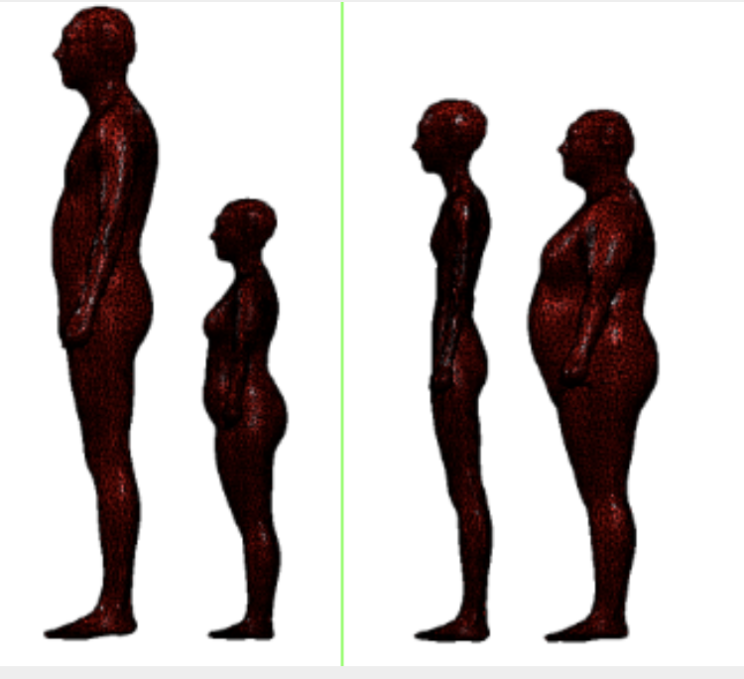
𝛽 indicates the size of the 10(generally) principal component offsets
User A has the following body measurements:
height 170cm, weight 60kg, waist circumference 80cm.
coefficients 𝛽=[0.5, −0.3, 0.2]
This means that relative to the base model, User A's model will increase in the height principal component (positive coefficient), decrease in the weight principal component (negative coefficient), and have a slight increase in the waist component.

Slide 20
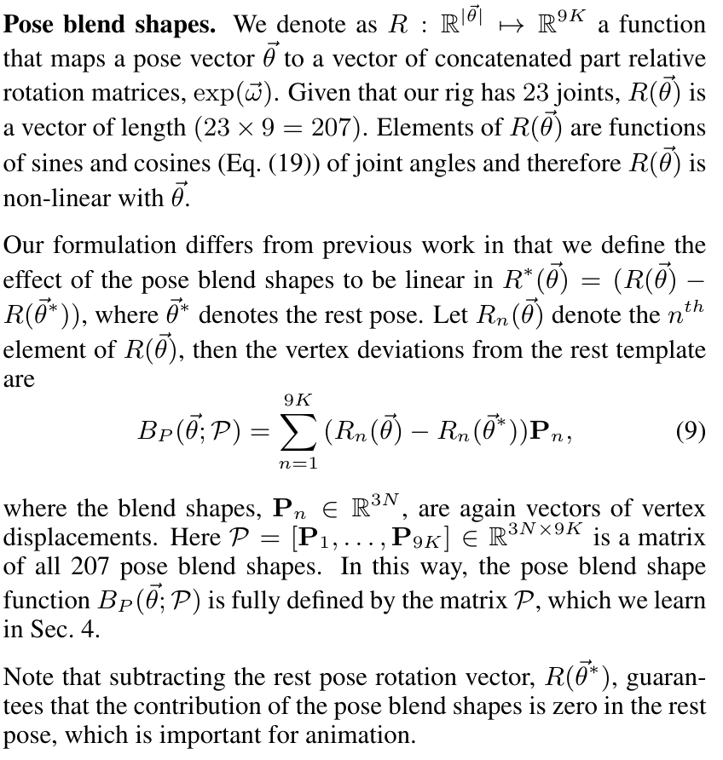
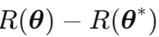
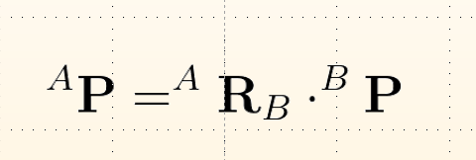
Pose blend shapes
θ ∗ indicates the rest pose.
Represents the offset of the joint
New Position = Ration Matrix * Old Position
P was trained by multi-pose data set within 1700 man and 2100 woman

Slide 21
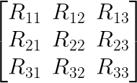
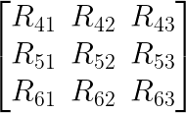
Left Shoulder Joint Rotation Matrix (3x3):
Right Shoulder Joint Rotation Matrix (3x3):
Flatten the left shoulder's rotation matrix into a 9-element vector:
Concatenate both 9-element vectors to form an 18-length pose vector (since we have two joints):
Matrix has 207 pose blend shapes

Slide 22
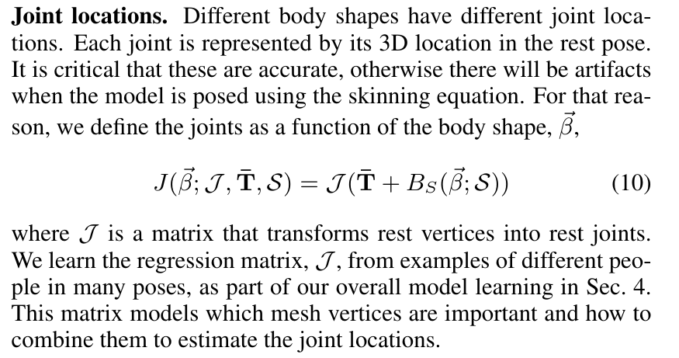
Joint Location
J is the regression matrix, learned from examples of different human bodies in various postures. We also can see it as a transformation matrix.

Slide 23
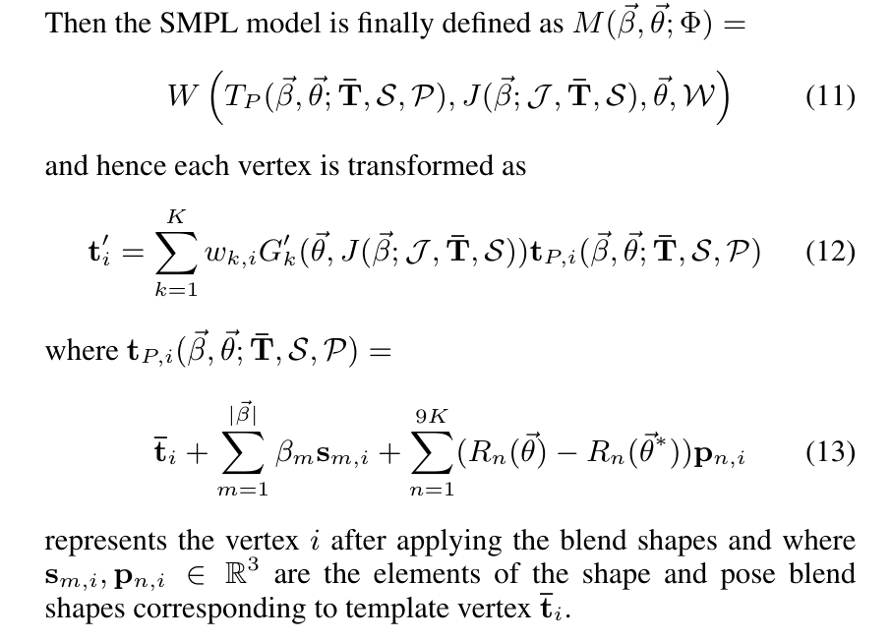
Summary

Slide 24
Training

Slide 25
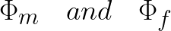
Fundamental
We first train {J, W, P} using our multi-pose dataset and then train {T¯, S} using our multi-shape dataset.
We train separate models for men and women

Slide 26
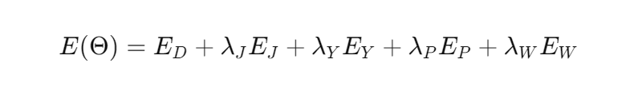
1. Pose parameter training
In the SMPL model, regularization typically involves several aspects:
Vertex Displacement Regularization (E_D)
Joint Location Regularization (𝐸_𝐽)
Pose Regularization (𝐸_𝑃)
Skinning Weight Regularization (𝐸_𝑊)
Symmetry Regularization (𝐸_Y)

Slide 27
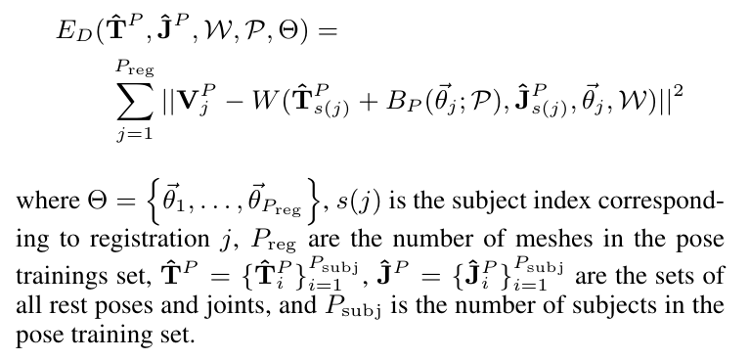
Vertex Displacement Regularization(E_D)

Slide 28
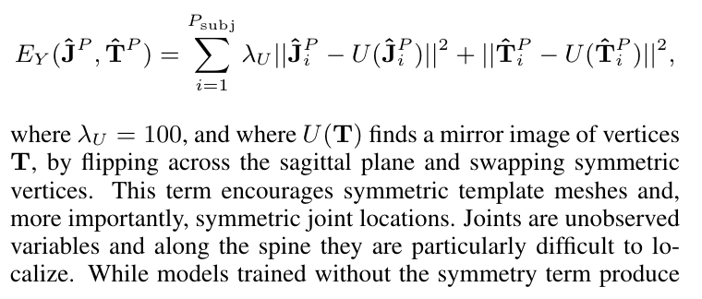
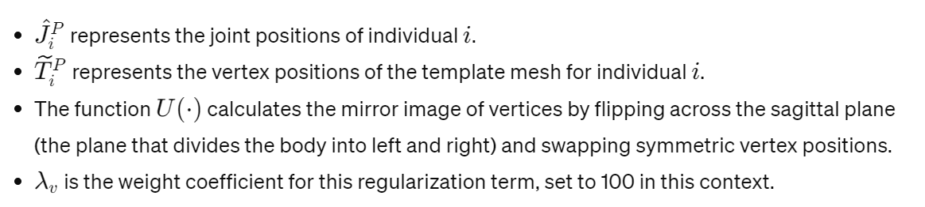
Symmetry Regularization (𝐸_Y)

Slide 29
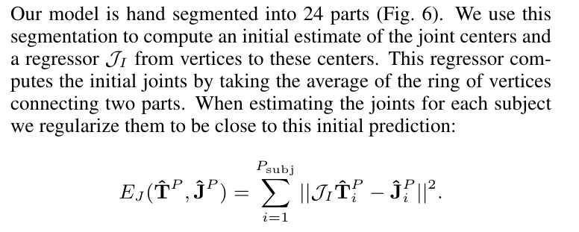
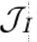
Joint Location Regularization (𝐸_𝐽)
Is the transformation matrix that can transform the vertex location to the joint location

Slide 30


Pose Regularization (𝐸_𝑃)
Frobenius norm
It measures the size of the matrix elements and is a way of measuring the overall size of the matrix.
m is row and n is column

Slide 31

Overfitting
The green line is overfitting
We want the change to be slow, so the w must close to 0.

Slide 32



Skinning Weight Regularization (𝐸_𝑊)
This helps control the influence of each bone on the vertices within its range of influence, avoiding unrealistic effects from excessively large weights.

Slide 33



Joint Regression
Using non-negative linear regression to optimization. After optimization, fewer vertices are needed to define the joints accurately, reducing complexity and potentially increasing computational efficiency.

Slide 34




2. Shape parameter training
Is edge of the model
Original mesh
Mean shape from multi-pose
Mean joint location from multi-pose

Slide 35


Slide 36

Optimization

